Slide 1
Post-Pandemic Travel Demand Modeling and Forecasting
San Francisco’s Experience
2025 Modeling Mobility Conference, Travel Behavior Trends Session
9/15/2025

Slide 2
Agency and Model
San Francisco County Transportation Authority
County transportation authority overseeing local sales tax
Congestion Management Agency for San Francisco
Maintain and apply an Activity-Based Model
SF-CHAMP
Currently uses DaySim for the demand model (since ~2018)
Pre-pandemic model version updated and re-estimated for a 2019 base year (completed 2023)
New post-pandemic model version represents a 2023 base year (completed early 2025)
Nomenclature
2019: CHAMP 7(BCE) – Before “COVID” Era
2023: CHAMP 7CE – “COVID” Era

Slide 3
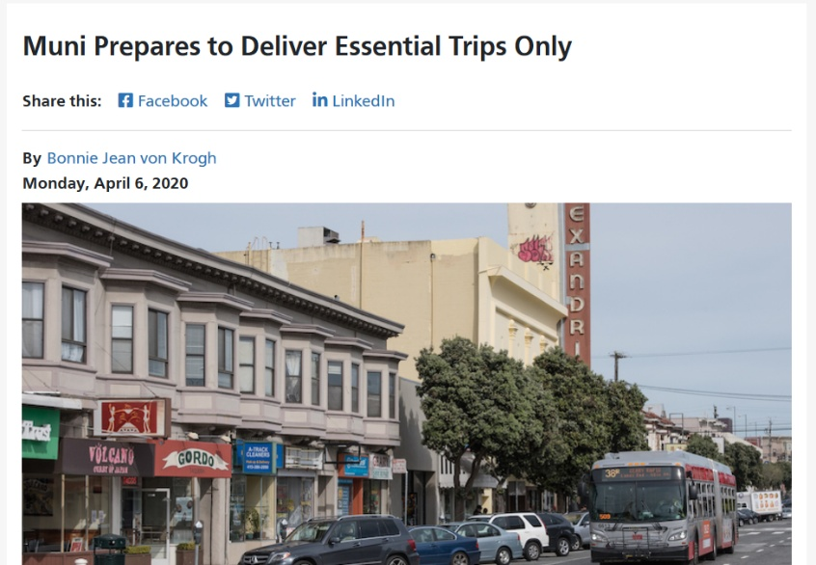
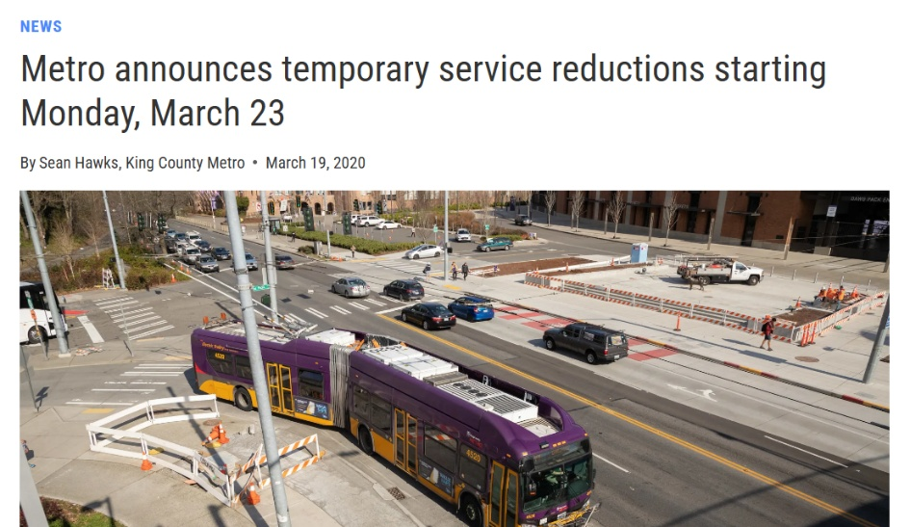
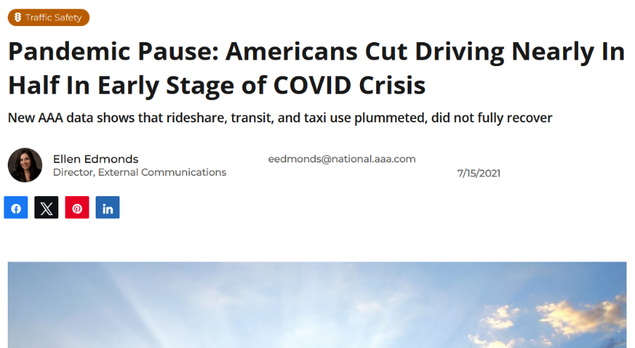
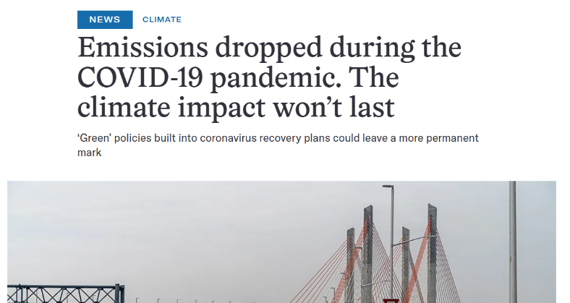
Changing Conditions
2020 – Pandemic starts
This is a brief disruption, expect behavior patterns to return to long term trends
Travel Forecasting
Use existing models with pre-pandemic bases for long term forecasts
Quick response scenario-testing for short term
2024/2025
Behavior has not returned to pre-pandemic norms
Does not seem to be on track to do so anytime soon
Models reflecting pre-pandemic conditions appear dated, lack confidence of decision makers and public

Slide 4
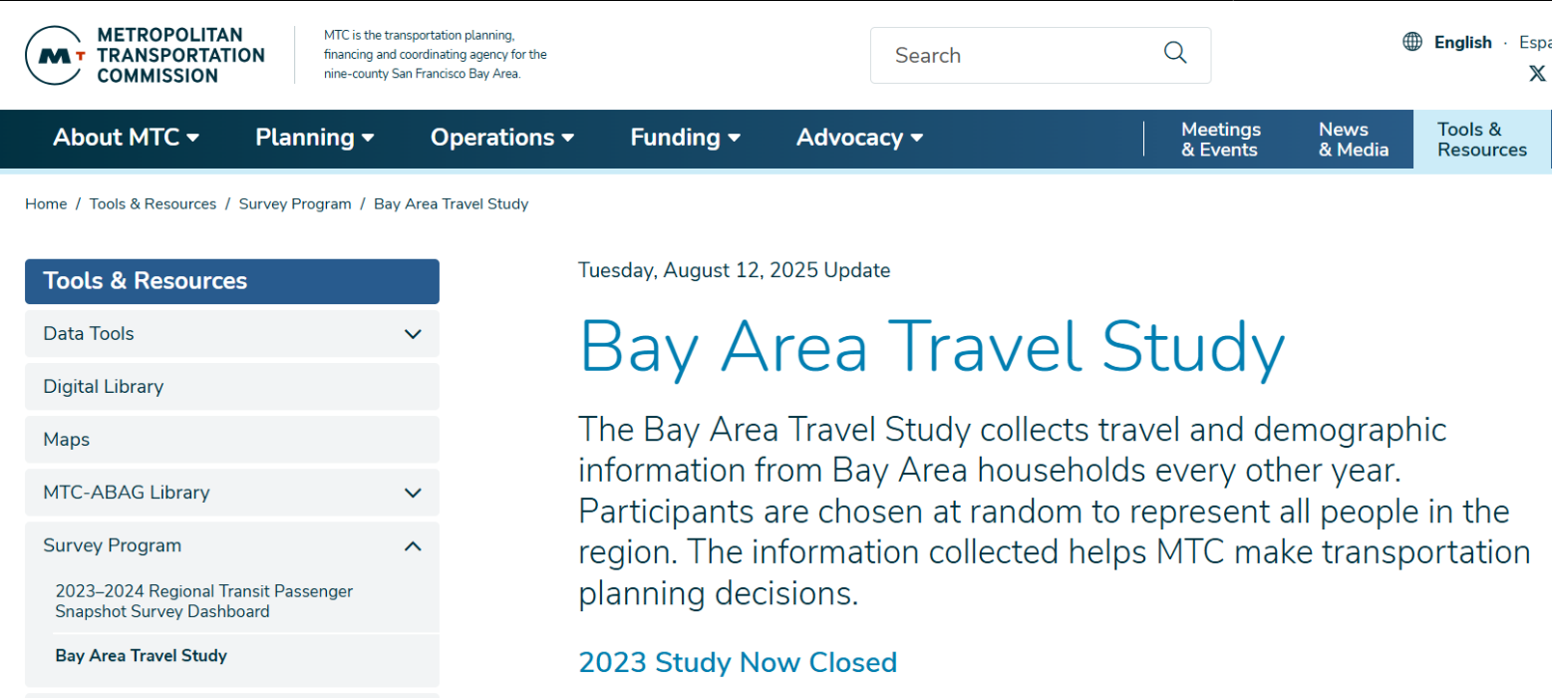
Post-Pandemic Model Update Considerations
Data needs
Activity-based models are data hungry – inputs, calibration, validation
Necessary inputs have time lag
Some data collection on hold during pandemic
Data availability status
Census and other land use data sources now runs through at least 2023
Return of transit surveys
Household survey - 2023 Bay Area Travel Survey
mtc.ca.gov/tools-resources/survey-program/bay-area-travel-study

Slide 5
Post-Pandemic Model Update Considerations
Behavioral stability
Rapid behavior changes make a model obsolete quickly
Are observed travel changes due to behavioral preferences or variable model inputs?
Observed travel behavior
Transit
SF transit ridership recovery growth slowed significantly by 2023
BART change 2021-2022: +69%
BART change 2023-2024: +5%
Traffic
Bay Area toll bridge crossings roughly stable by 2022
Bay Bridge 9% lower than pre-pandemic
Other bridges 12-15% lower

Slide 6
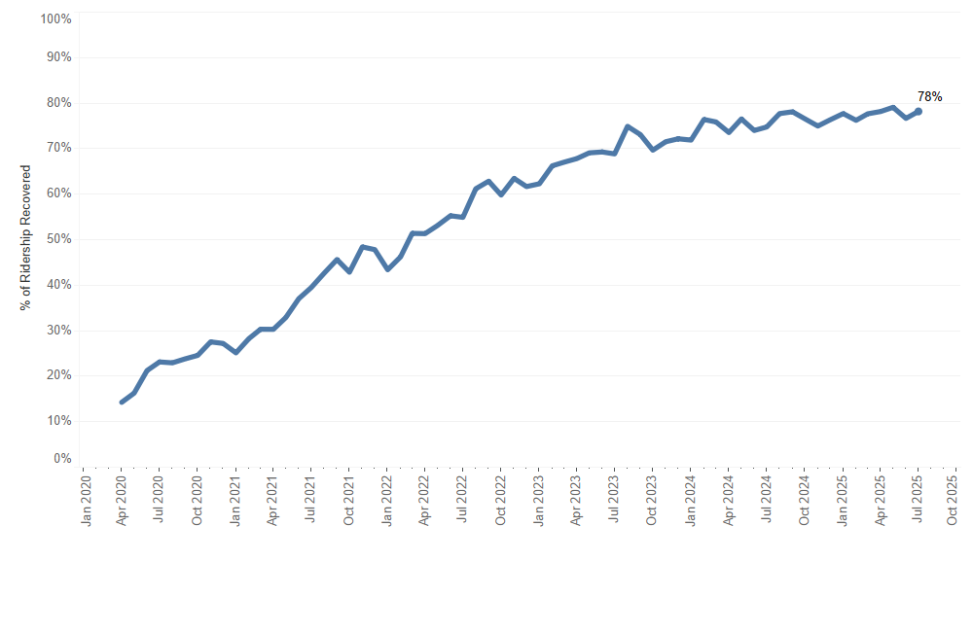
Muni Ridership Recovery, % of Pre-Pandemic
2023

Slide 7
Post-Pandemic Model Update Considerations
Needs of model clients
Who needs our model, for what, and when?
Answers
Planners
Multiple project studies and a Countywide Plan
Yesterday, please

Slide 8
Post-Pandemic Model Update Approach
2024, with new data in hand and urgent demand for a post-pandemic model
Set 2023 as new base year
Updates / improvements
Transport networks
2023 land use / synthetic population
Re-calibrate DaySim choice models
Validate with available 2023 observed data
Implement SimWrapper validation workbook
Quickly move into production to meet planning schedules

Slide 9
Updating SF-CHAMP
Transport Networks
Significant change in transit service, routes, frequencies
Mostly less service (and less demand)
More evenly distributed service across time of day and days of week
Change in Transit Service Provision, 2019 to 2023 (NTD)
Operator | Veh Rev Miles | Veh Rev Hours
SF Muni | -9% | -7%
BaRT | +7% | +19%
Caltrain | -12% | -19%
AC Transit | -19% | -17%
Golden Gate Transit | -50% | -49%

Slide 10
Updating SF-CHAMP
Land Use
Data Sources
Census 2023 American Community Survey
1-year
5-year
California Department of Finance Population Estimates
Census LEHD Origin-Destination Employment Statistics / QCEW
California Employment Development Department
San Francisco Planning Department local land use data

Slide 11
Updating SF-CHAMP
Land Use
Population decline, 2019-2023
Disagreement between CA Dept of Finance and Census ACS
Census estimated decline of 8%
Changing household structure
Despite population loss, SF households increased by 2%
Census estimated HH size fell from 2.36 in 2019 to 2.09 in 2023

Slide 12
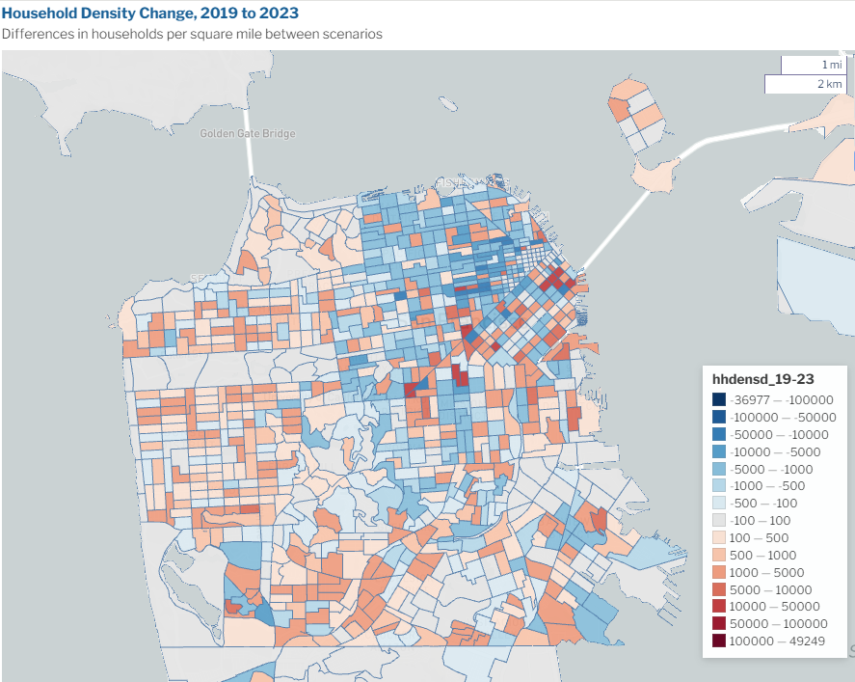
Updating SF-CHAMP
Land Use
Aging population
More 65+ residents
Biggest drop in 18-44
Increased auto ownership
2% more households with vehicles
Limited post-pandemic land use and socioeconomic data at smaller geographies

Slide 13
Updating SF-CHAMP
Land Use
Modest changes in employment
3% drop in San Francisco jobs, 2019-2023 (2023 on par with 2017/2018)
No change from 2019 to 2023 in employed residents
But job locations don’t mean what they used to
With high remote work rates, a job data job became even less representative of a workplace destination than before (jobs data has always been messy)
Mismatch between jobs reported in data and the quantity of regular commuting
Addressed in SF-CHAMP by making a percentage of jobs in each county unavailable for work location choice

Slide 14
Updating SF-CHAMP
Calibration Data
Mostly sourced from 2023 household travel survey
Remote Work
Fully remote work in San Francisco from 7% pre-pandemic to 24% in 2023
Typical weekday in 2023 – 60% as many work tours as pre-pandemic
Fully Remote Work, 2019 and 2023
Area | 2019 ACS | 2023 ACS | 2023 HHTS
San Francisco | 7% | 24% | 24%
Bay Area | 7% | 18% | 18%

Slide 15
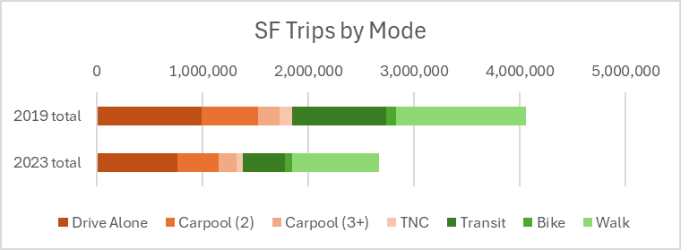
Updating SF-CHAMP
Calibration Data
Significantly less trip-making in 2023, and a greater share of trips are drive trips
1/3 fewer trips to/from/within SF
Transit mode share dropped by 7%
Auto modes share increased by 6%
Average daily trips to/from/within SF by Bay Area residents (excludes goods delivery, commercial, freight, visitor travel)

Slide 16
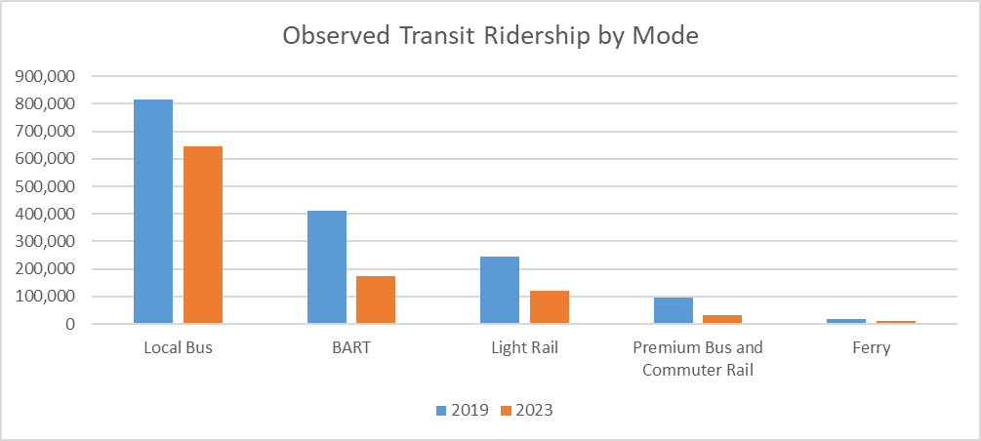
Updating SF-CHAMP
Calibration Data
Transit ridership patterns unevenly distributed
Regional rail has had weakest recovery (less than 50% of ‘19)
Local bus most resilient (-21%)
Off-peak and weekend travel account for greater shares of transit ridership

Slide 17
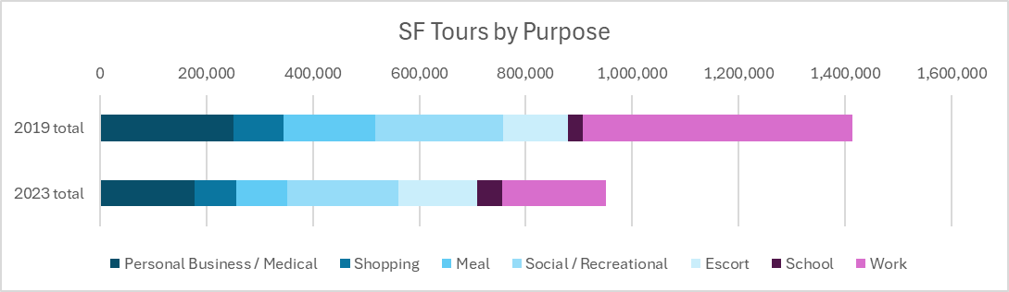
Updating SF-CHAMP
Calibration Data
Work is no longer the dominant tour purpose
Work tours decreased the most followed by Meal
31% fewer tours overall
Average daily tours to/from/within SF by Bay Area residents (excludes goods delivery, commercial, freight, visitor travel)

Slide 18
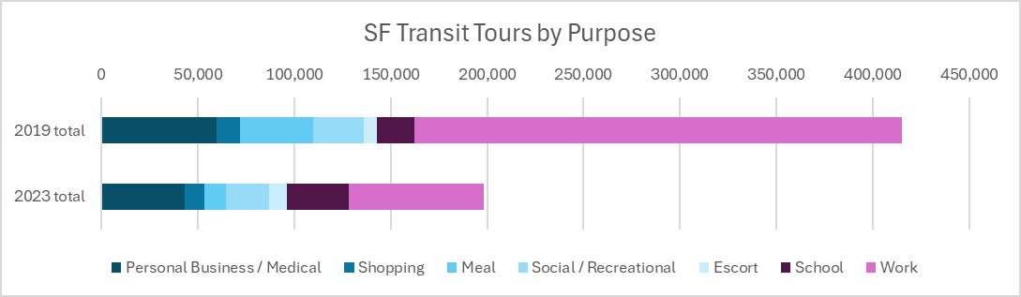
Updating SF-CHAMP
Calibration Data
Transit tours no longer dominated by work/school purpose
Overall transit tours are down 51%
In 2019, 61% of transit tours were for work; in 2023, only 35%
School and escort transit tours increased in absolute terms
All other trip purposes have declined, but not as much as work trips
Average daily transit tours to/from/within SF by Bay Area residents (excludes goods delivery, commercial, visitor travel)

Slide 19
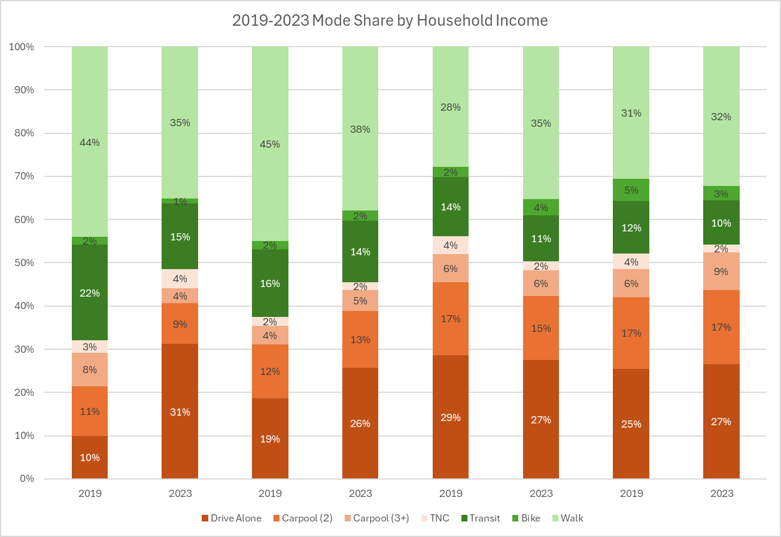
Updating SF-CHAMP
Calibration Data
Mode share and change by household income
Largest changes in lower income groups
Fewer differences by income in 2023
Transit use fell for everyone, but especially the lowest income group
The lower income groups are driving more

Slide 20
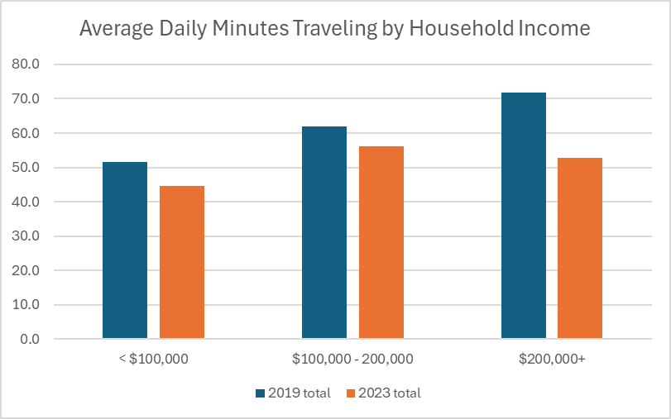
Updating SF-CHAMP
Calibration Data
SF residents spend less time traveling in 2023
People are traveling less in general
People are driving more, which is faster
Higher income households have the largest drop in travel time (26%)
Trips by SF residents only

Slide 21
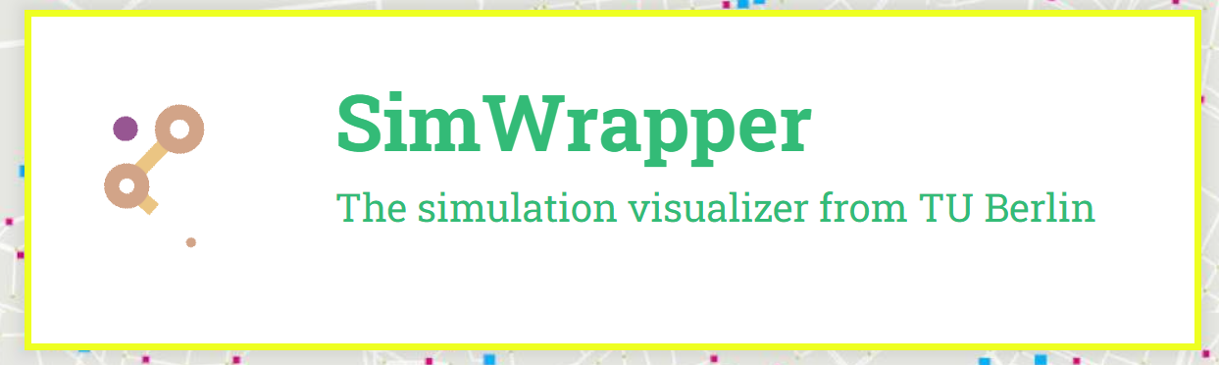
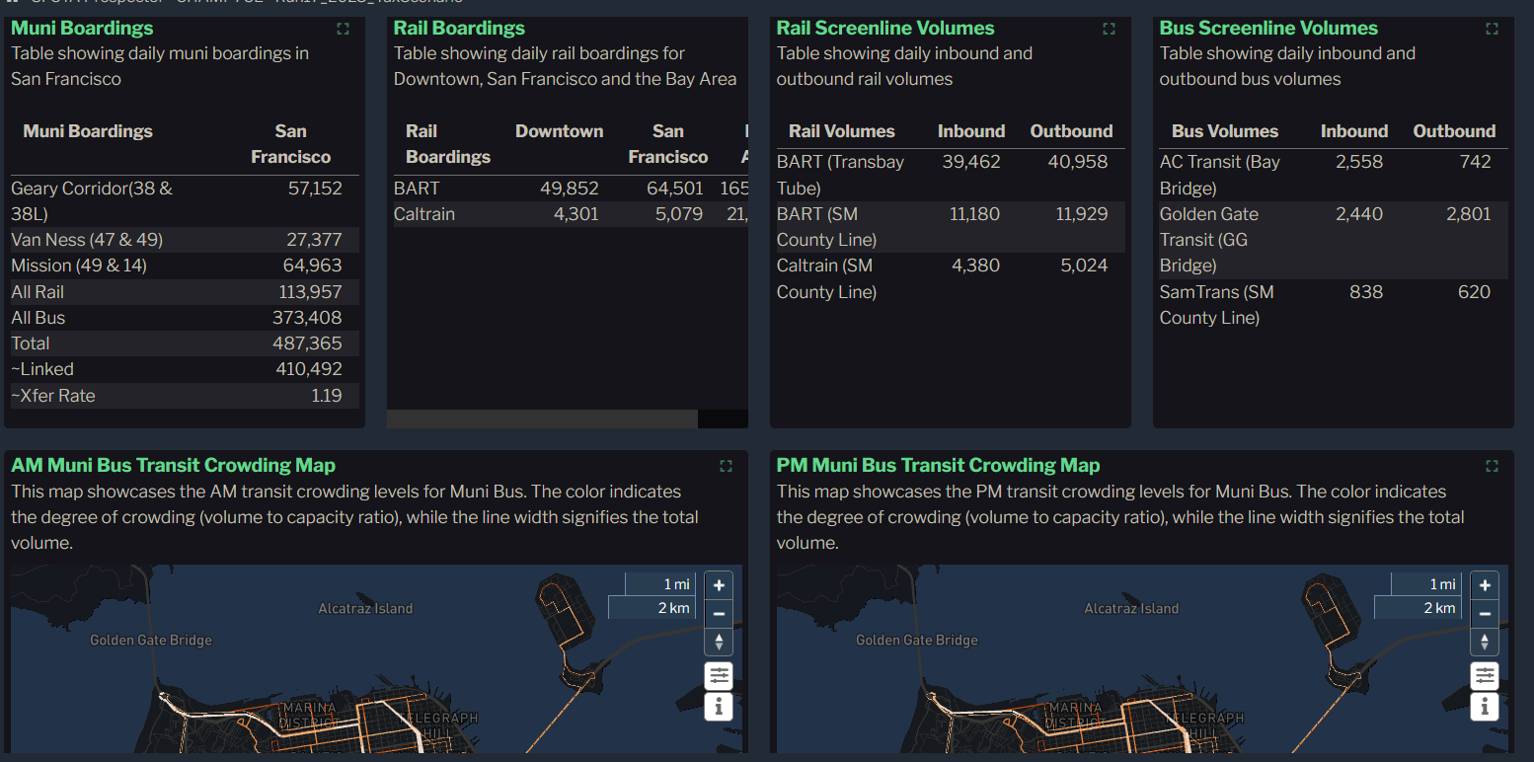
Updating SF-CHAMP
Model Validation
Implemented SimWrapper model run summary and validation workbook for easy, automated validation comparisons
https://docs.simwrapper.app/
Transit topsheet in SFCTA SimWrapper model summary and validation visualization

Slide 22
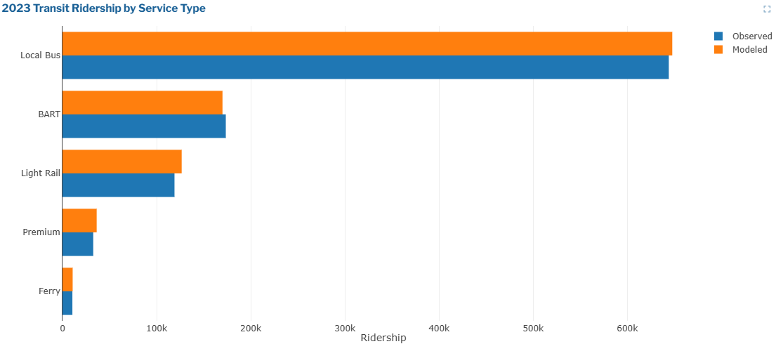
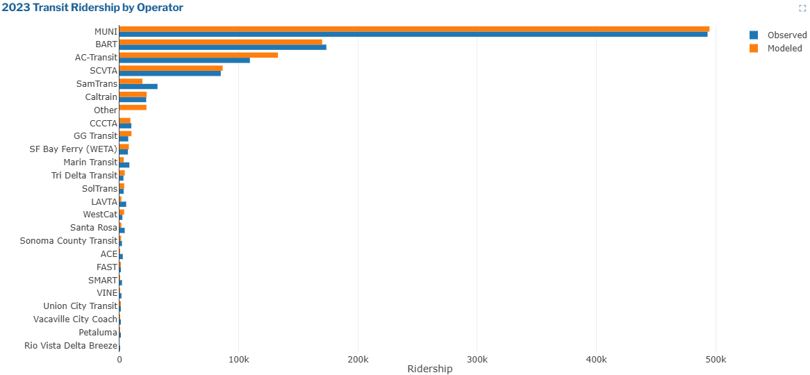
Updating SF-CHAMP
Model Validation
Transit ridership validation examples
2023 weekday transit boardings by service type
2023 weekday transit boardings by operator

Slide 23
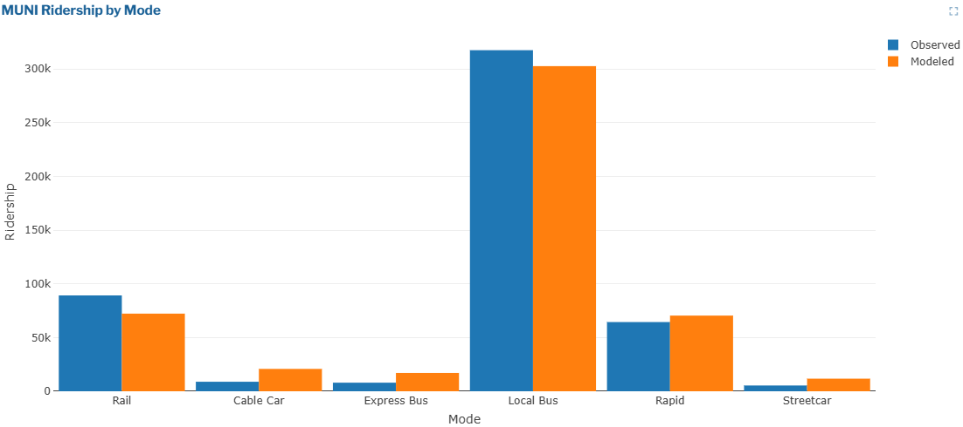
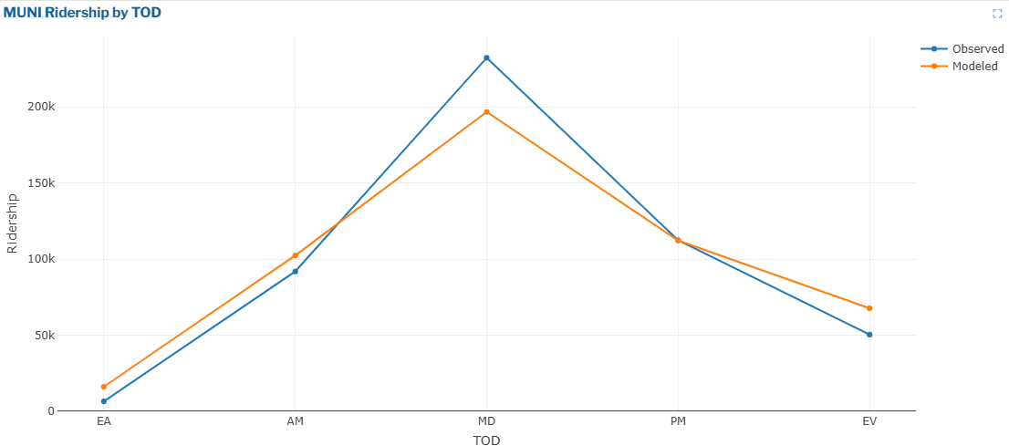
Updating SF-CHAMP
Model Validation
Transit ridership validation examples
2023 weekday Muni ridership by sub-mode
2023 weekday Muni ridership by time of day

Slide 24
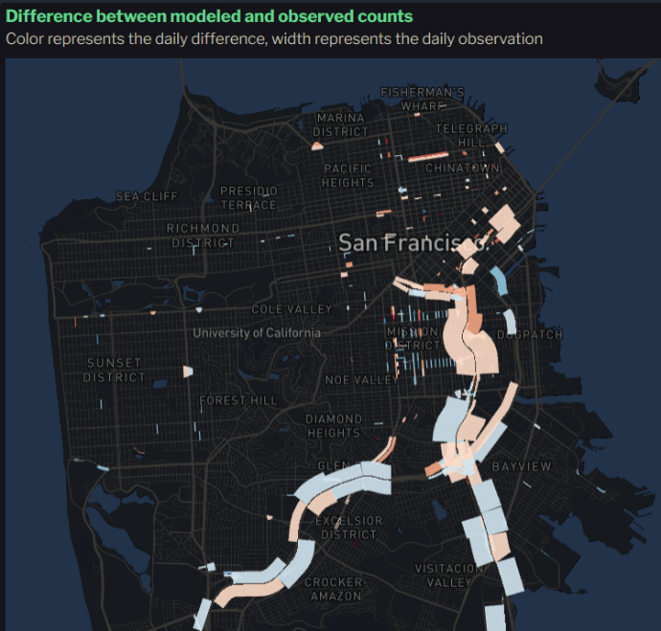
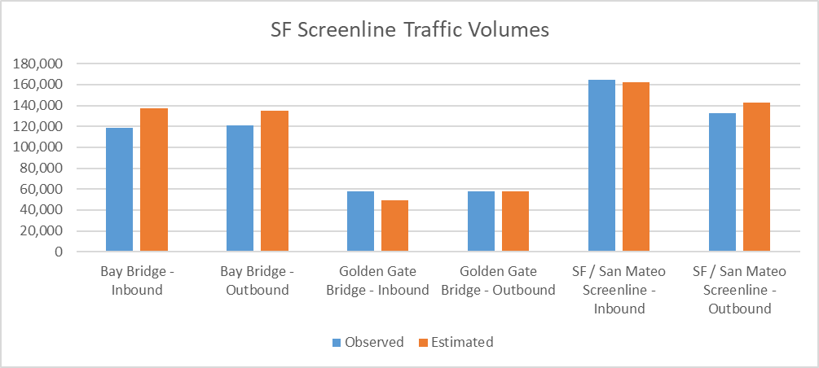
Updating SF-CHAMP
Roadway validation
Difficult to find adequate data – no comprehensive count program
Used any counts we could find spanning roughly 2022-2024
Data quality issues from some sources

Slide 25
Updating SF-CHAMP
Results
Future year forecasts differ considerably between pre-pandemic (CHAMP 7) and post-pandemic (CHAMP 7CE) model versions (yes, land use and networks differ too)

Slide 26
Ongoing Considerations
Travel behaviors haven’t really stabilized
Frequent news articles about new back to work policies – maybe this time companies mean it
Transit ridership in Bay Area seems to be continuing to grow faster than would be expected by population and economic growth alone
Is a 2023-based model appropriate for future year forecasting?
Assessing model performance over short term
Back casting isn’t an option – behaviors were different
Some time before short term re-validation, e.g. 2025, is possible
Weekly patterns have changed
Big deviation between Monday/Friday and Tuesday/Wednesday/Thursday, especially for transit ridership
Warrants extra consideration to what a weekday means in a travel model

Slide 27
Thank you.
Daniel Tischler
Principal Transportation Modeler
dan.tischler@sfcta.org

Slide 28
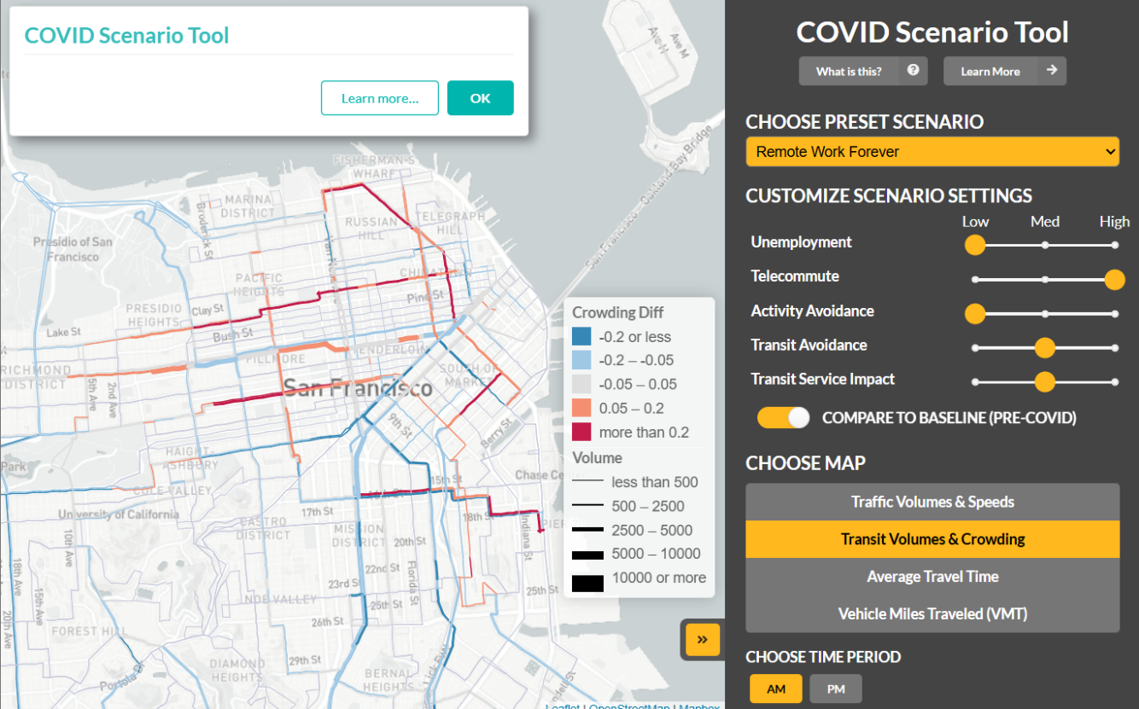
Early Pandemic Modeling
2020
Limited data
Rapidly changing conditions
Quick response tool
Pared down version of SF-CHAMP
Adjustments factors
Employment changes
WFH
Transit avoidance
Trip suppression
Network changes (transit service / toll changes)

